Slide 1

Team 3 Megalodon

Slide 2
PROJECT: GAME SHOP
Members:
1. Nguyễn Phát Đạt
2. Dương Ngọc Nguyên Phương
3. Nguyễn Văn An
4. Hà Vũ Đạt
5. Nguyễn Hữu Sơn

Slide 3
PROJECT: GAME SHOP
CONTENT
OVERVIEWS
FLOWCHART
USE-CASE
STORY BOARD

Slide 4
OVERVIEWS
Classification | Content
Service | Display various games with recommended options, payment method, discount, feedback.
Background | We’re trying to combine user-friendly and aesthetically-pleasing features, ensure your account privacy.
Purpose | Help customer easy to search game product, providing qualified games for customer with many different competitive level of price.
Expectation | Increasing approaching ability with many type of clients, help save the time and effort for shop’s owner, increasing profit and earning for shop.
Main functions | + Login/Register/Logout. + Manage Game Products + Cart (Buy, Edit), Payment + Search + Statistics, Manage users, Category, comments, Blog (News)
Targeted clients | Concerned objects
Service channel | Web
Publishing time | 23/07

Slide 5
2. FLOWCHART

Slide 6
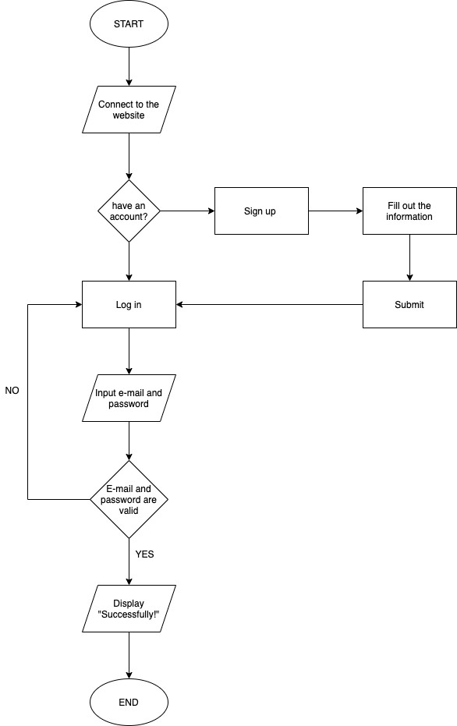
FLOWCHART
LOGIN

Slide 7
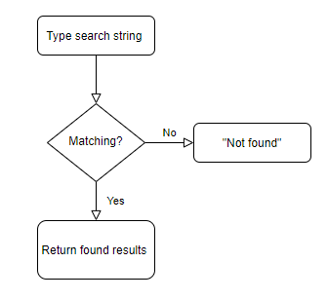
FLOWCHART
SEARCHING

Slide 8
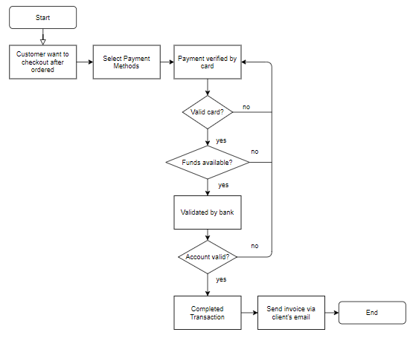
FLOWCHART
PAYMENT

Slide 9
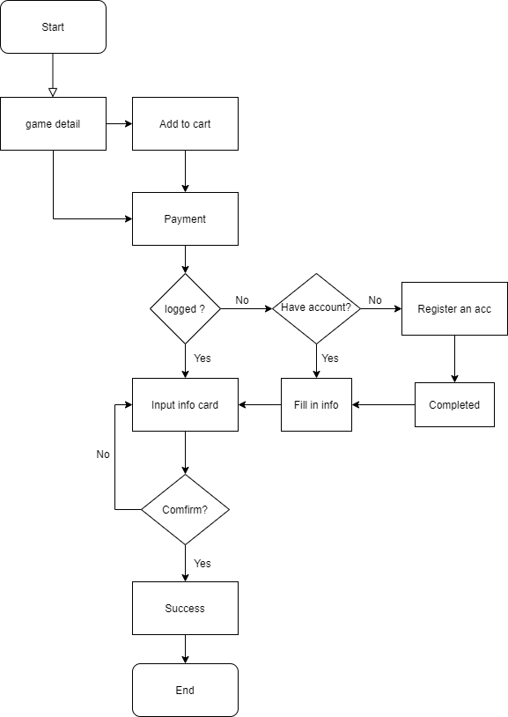
FLOWCHART
BUY GAME

Slide 10
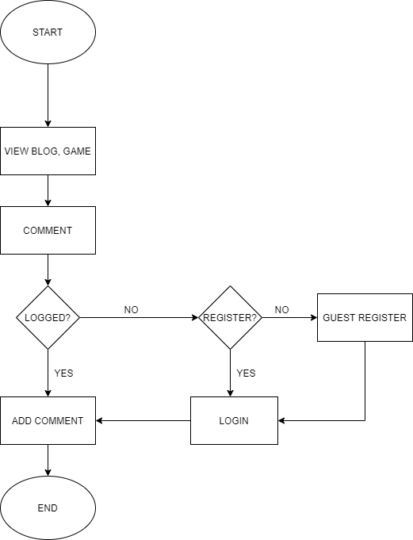
FLOWCHART
VIEW BLOG, GAME & ADD COMMENT

Slide 11
3. USE-CASE

Slide 12
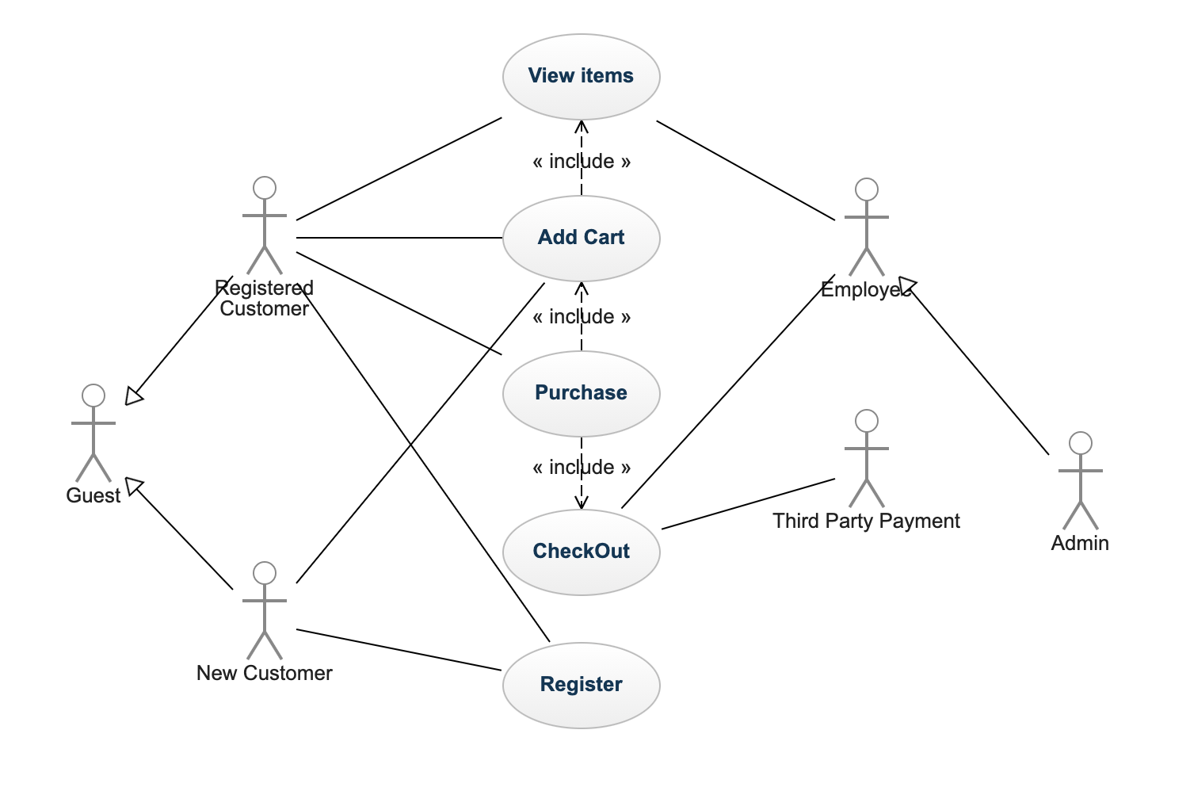
USE-CASE DIAGRAM
WEB CUSTOMER

Slide 13
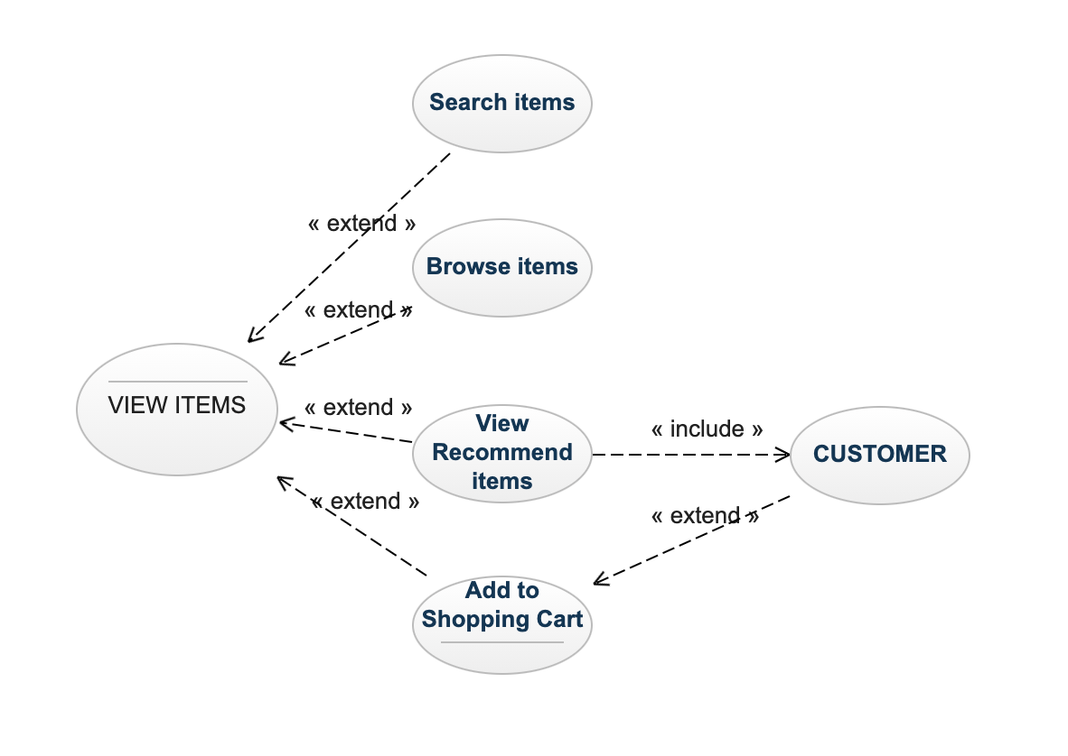
USE-CASE DIAGRAM
VIEW ITEMS

Slide 14
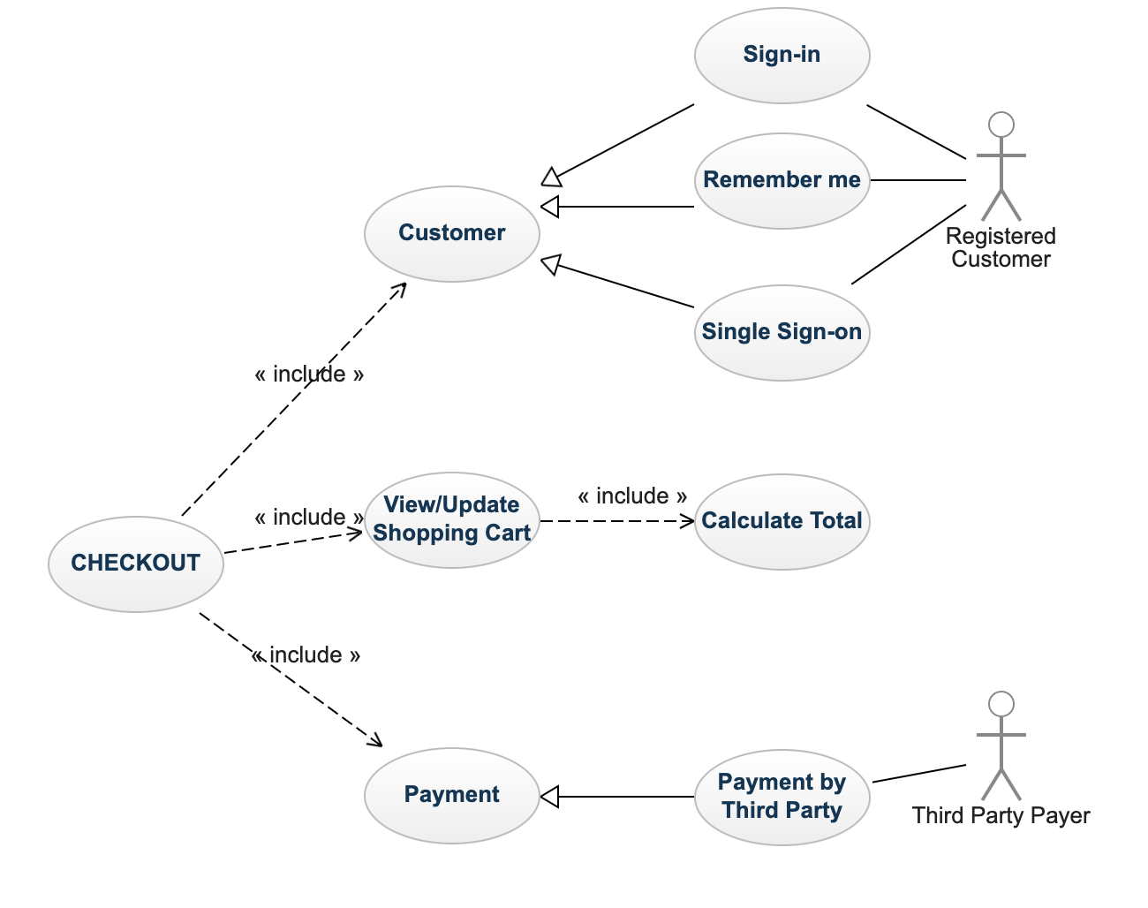
USE-CASE DIAGRAM
CHECKOUT

Slide 15
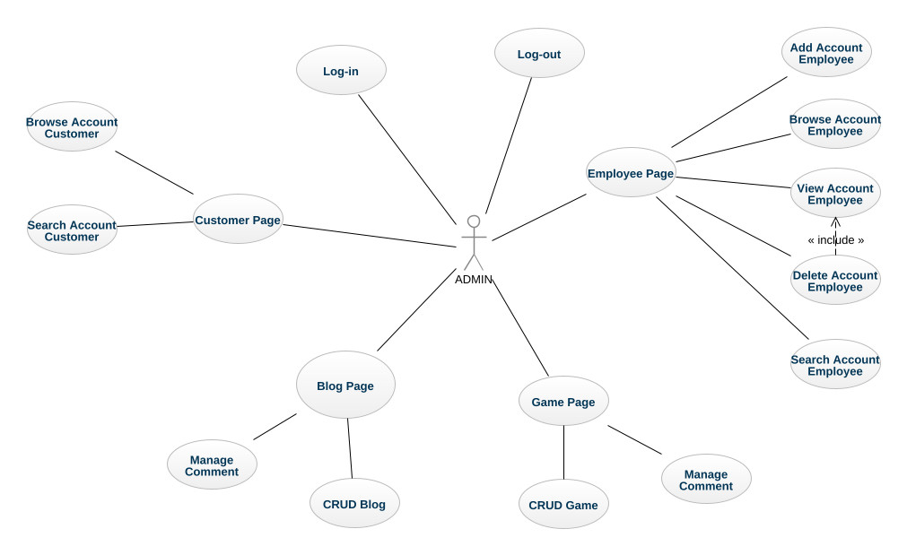
USE-CASE DIAGRAM
MANAGE - ADMIN

Slide 16
4. story board

Slide 17
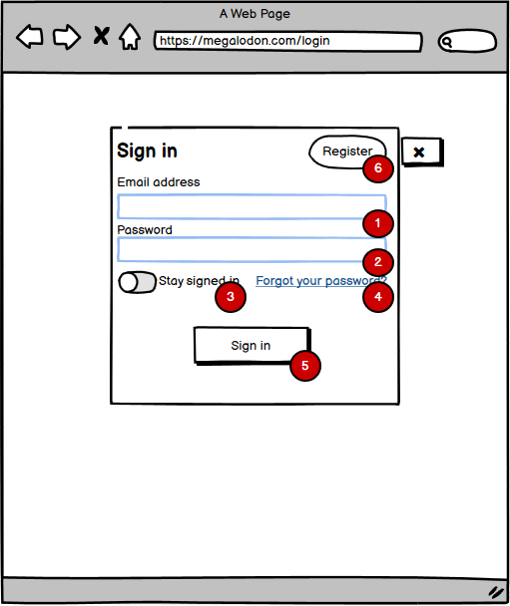
Log in
Description:
Input email account to login: Typing user gmail account,
Input password to login: Typing user password.
Button to save account and password: Used to save accounts and passwords on the local computer.
The link for forgot password case: Go to a web page and restore the former password.
Sign in Button: Used to login with suitable account and password go to different homepages belong to user’s role.
Button Register account:
Used to go to the Register page, used to create an account.

Slide 18
Admin Page

Slide 19
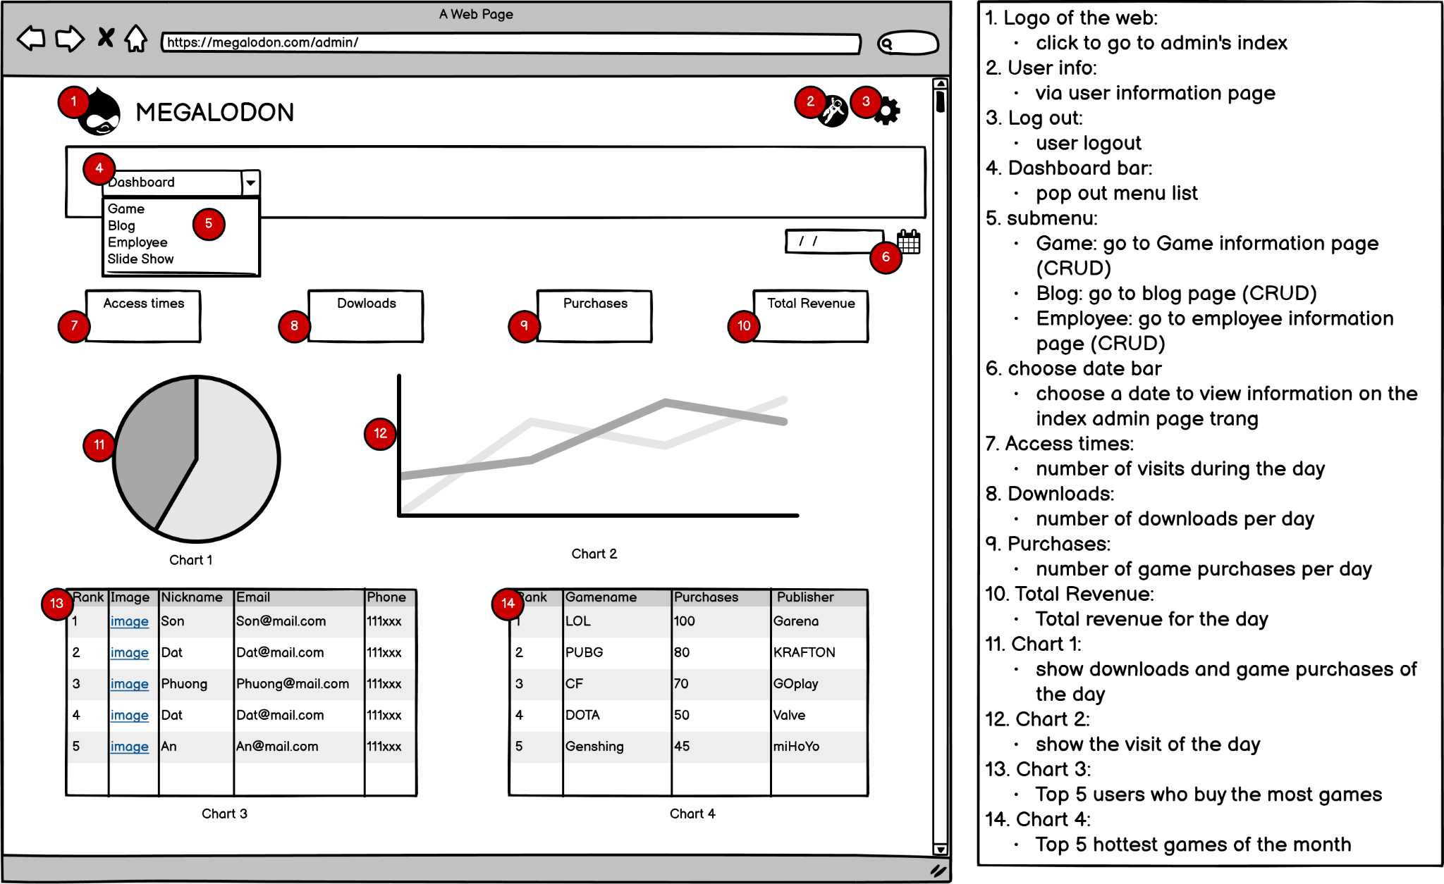
ADMIN HOME

Slide 20
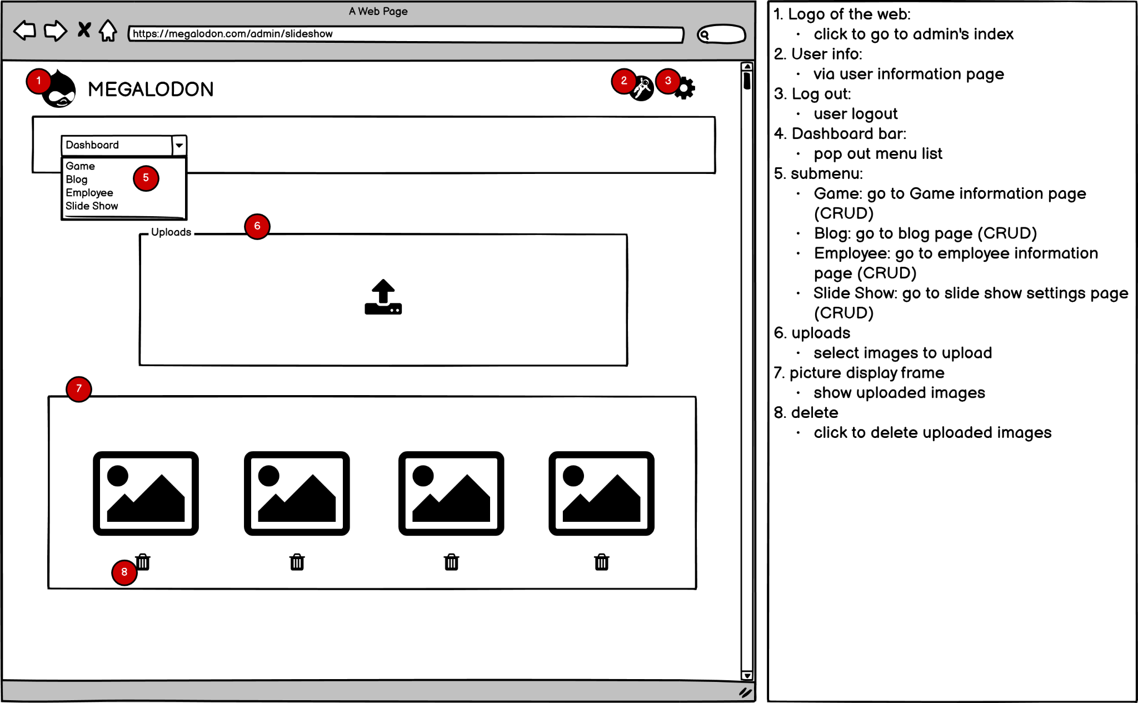
Manage slideshow

Slide 21
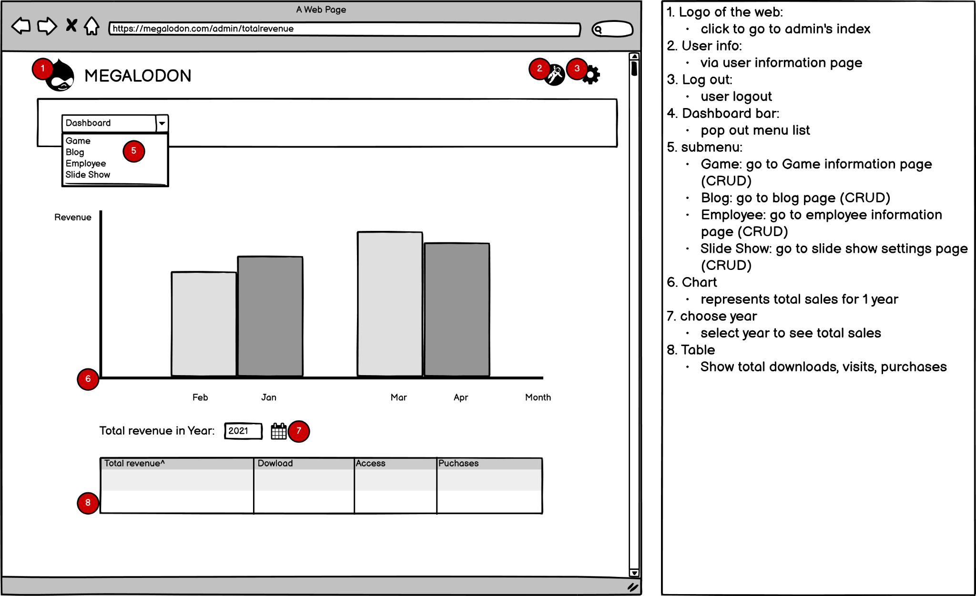
revenue statistics

Slide 22
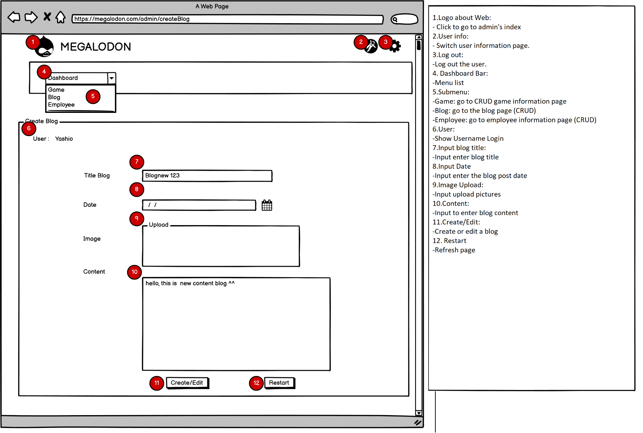
MaNage Blog

Slide 23
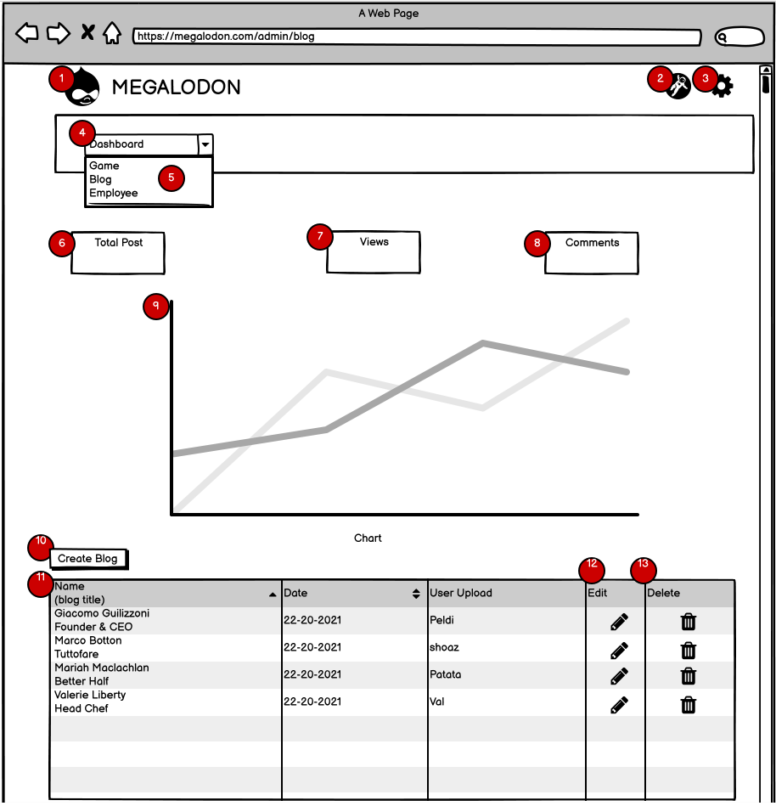
MAnage blog 2
Description:
Web logo: Click it to go to Admin Index page.
User Info: forwarding to user information page
Logout: log out current user.
DashBoard bar: drop menu items list down.
SubMenu:
Game: forwarding to Game management.
Blog: forwarding to Blog management.
Employee: forwarding to Employee management.
Total post: show total number of Posts.
Views: show total number of views.
Comments: show total number of comments.
Chart displays views by month.
Create Blog: go to New Blog page.
Table List Blog: display Blog List
Edit: go to edit corresponding Blog.
Delete: remove selected Blog.
Paging for showing Blog list by table.

Slide 24
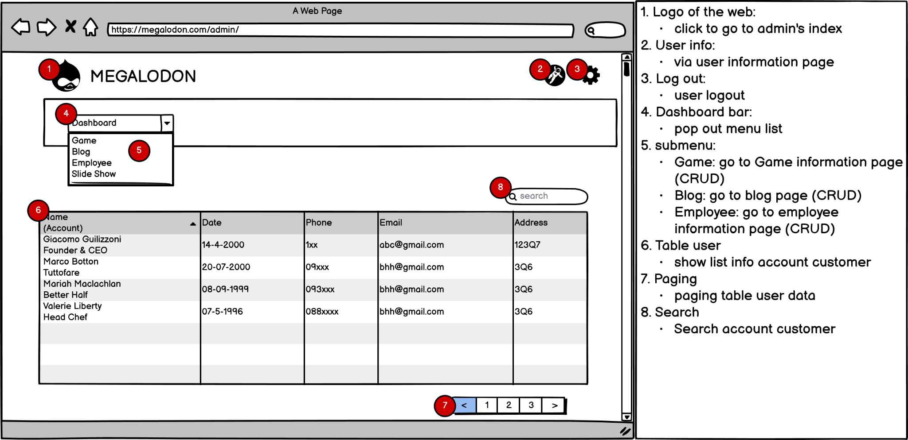
Manage admin

Slide 25
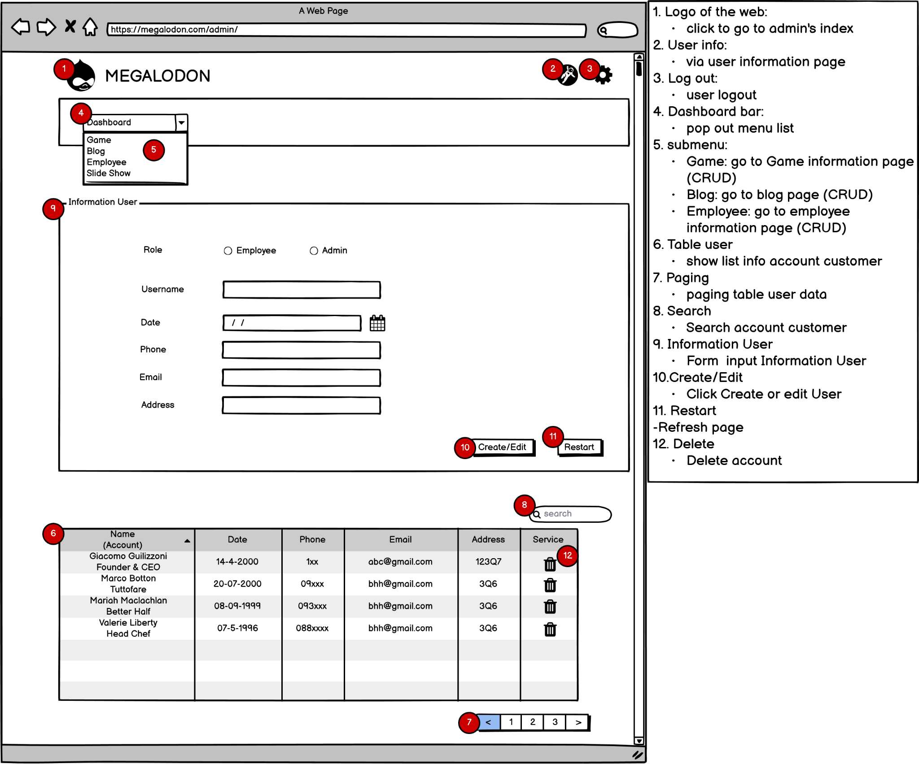
Manage user

Slide 26
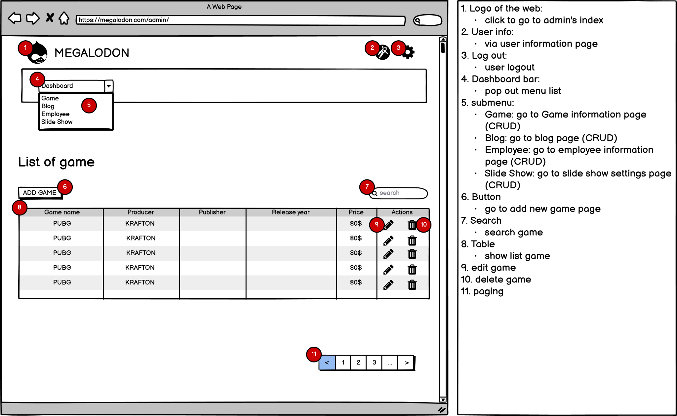
Manage game 1

Slide 27
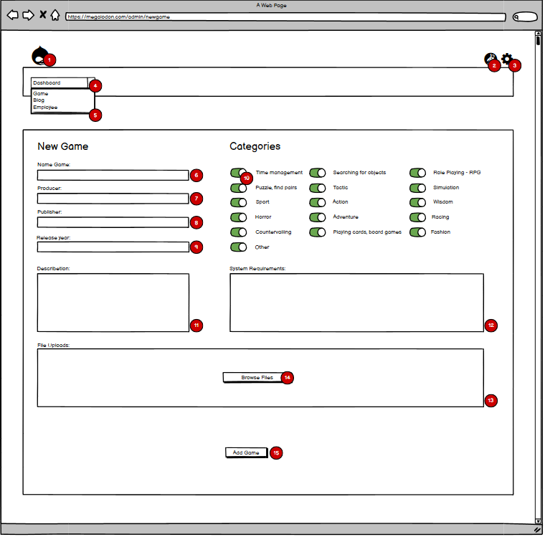
Manage game 2
Description:
1. Logo of the web:
- click to go to admin's index
2. User info:
- via user information page
3. Log out:
- user logout
4. Dashboard bar:
- pop out menu list
5. submenu:
- Game: go to Game information page (CRUD)
- Blog: go to blog page (CRUD)
- Employee: go to employee information page (CRUD)
6. Input Name Game:
- Enter game name.
7. Input Producer:
- Enter the manufacturer's name.
8. Input Publisher:
- Enter the publisher name.
9. Input Release year:
- enter the game release year.
10. Button Categories:
- Button to select Categories for the game.
11. Text Area Description:
- Used to enter a description of the game.
12. Text Area System Requirements:
- Used to enter the configuration to meet the configuration to run the game.
13. File Uploads:
- Used to download files of game images.
14. Button Browse Files:
- Used to retrieve images from a folder on your computer.
15. Button Add Game:
- Used to add Game to data.
Notes:
e biết r a
ần hình mô cho rộng e

Slide 28
game shop

Slide 29
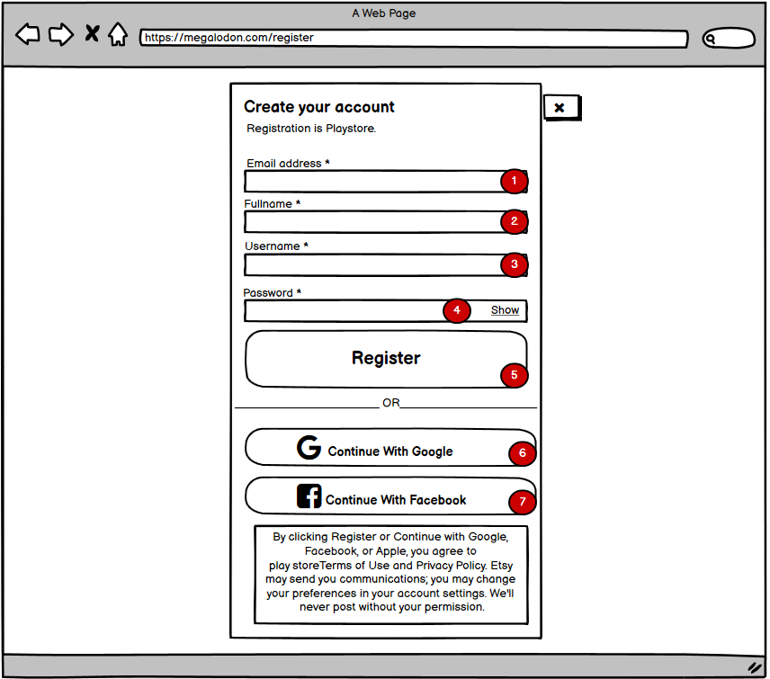
register
Description:
1. Input Email to register:
Enter the Email you want to create.
2. Input Fullname to register:
Enter your full name.
3. Input Username to register:
Enter the name in your website.
4. Input Password to register:
Enter your Password
Button show:
Used to let you review your password.
5. Button Register:
Used to create a new user or create an employee.
6. Google Email Account Button:
Link to google.
7. Facebook Email Account Button:
Link to Facebook.

Slide 30
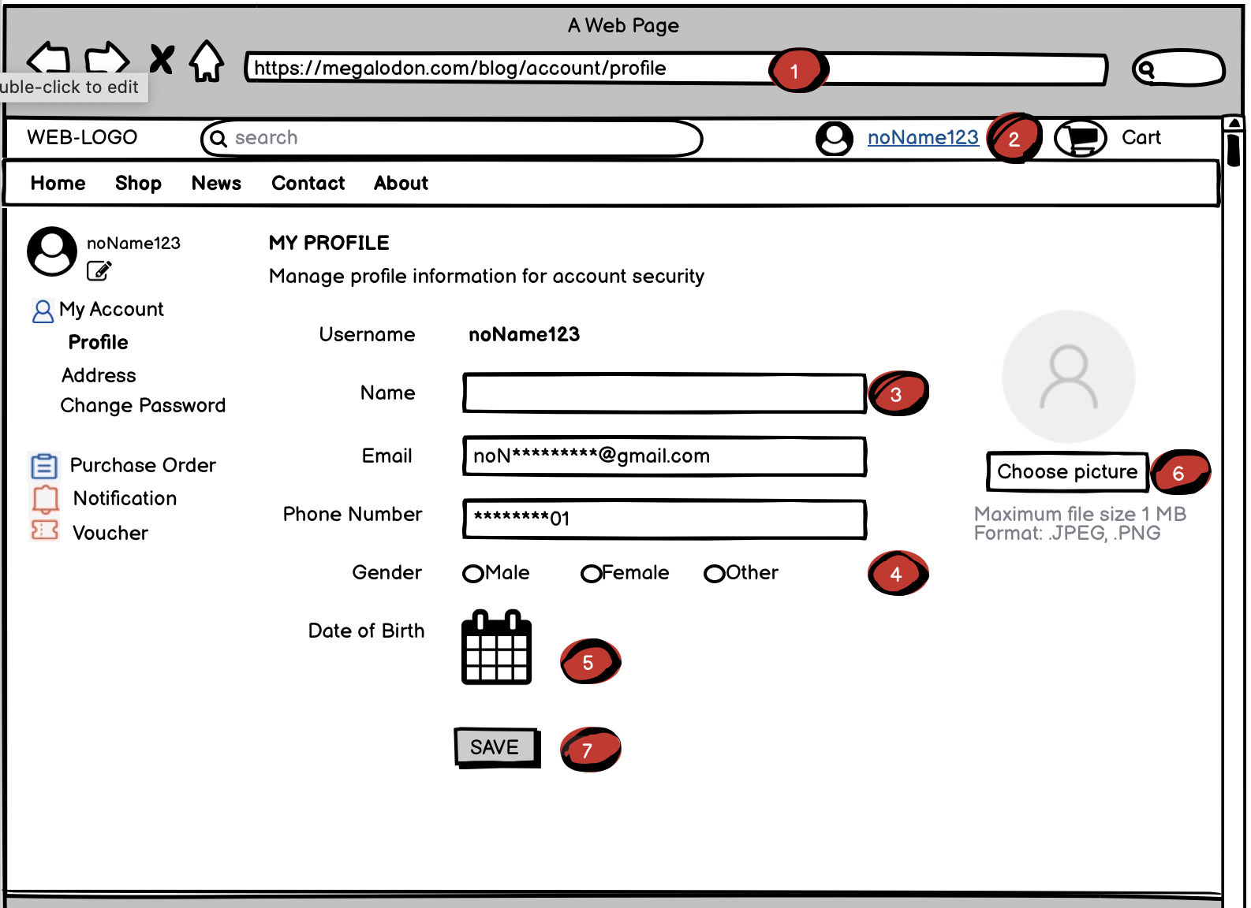
user account
DESCRIPTION (Account)
1. Firstly, visit the link to the Homepage.
2. Log-in successfully.
3,4,5,6. After choose “edit profile” when you move your mouse into <2>, you’ll see these info, it’s up to you to choose edit any things here.
7. Click this button to transport the database to our browser.

Slide 31
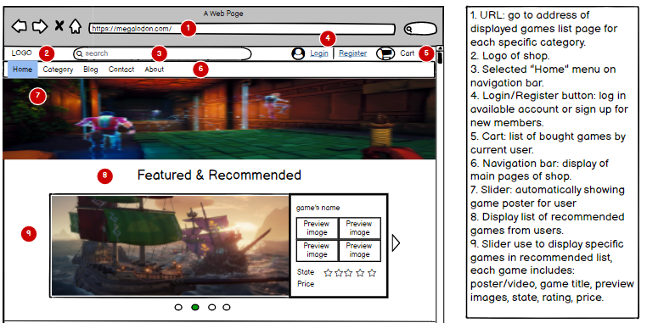
Home Page 1

Slide 32
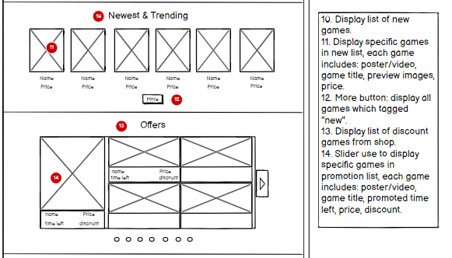
Home Page 2

Slide 33
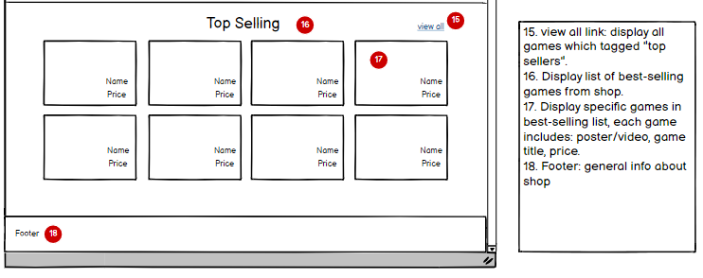
Home Page 3

Slide 34
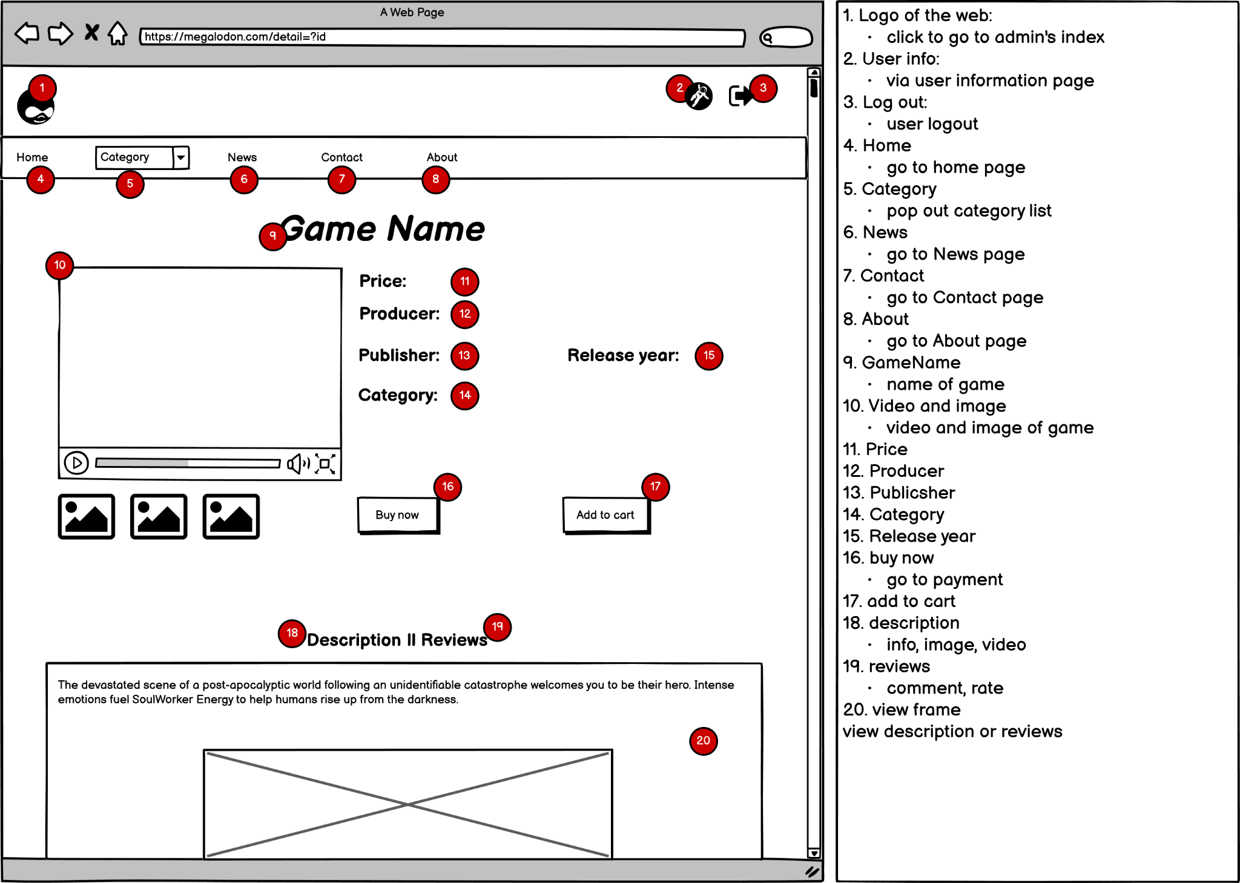
game details

Slide 35
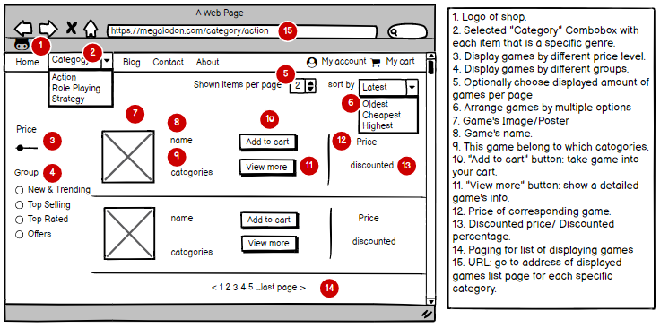
Category game

Slide 36
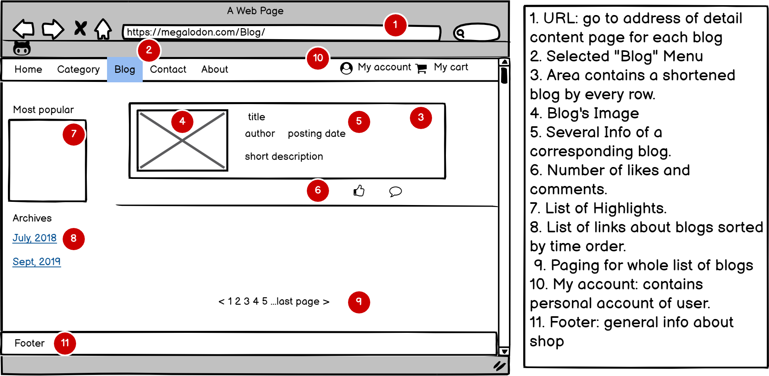
Blog

Slide 37
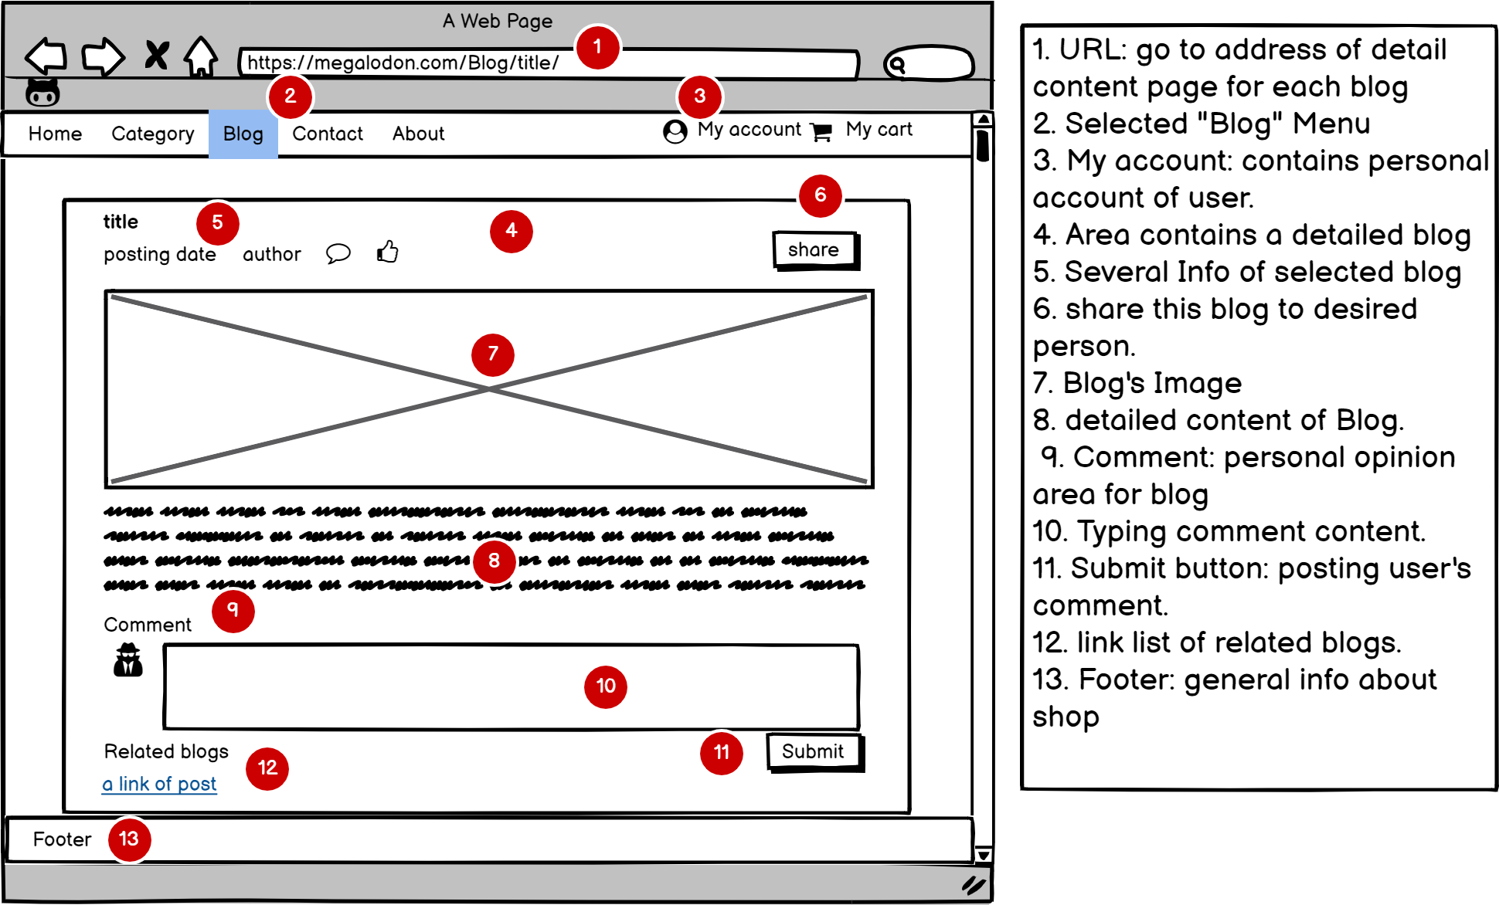
blog details

Slide 38
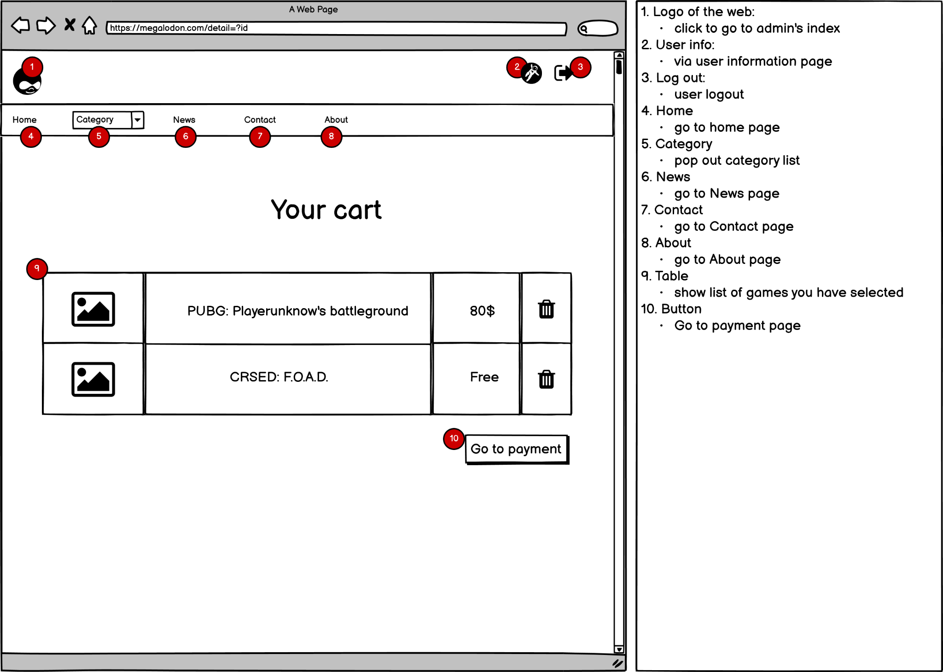
cart

Slide 39
BIll and cart
The cart’s data will be saved to session from the server side, which will save system resources when using too many requests for CRUD operations as well as helping reduce the amount of stored data in the database when users want to change their mind and does not want to buy the product, or due to unintentional mistakes from users or some objective reason causes an error that causes stored information in the session can be lost. However, if the mentioned case happens, it will not affect the current database system because the user's ordered information will only be saved when the intermediary payment party returns successful payment notification, on the other hand if session information is lost, the cart’s stored information will also disappear, so the bill payment cannot be done and the bill will not be saved in the database. Meanwhile, if the order information has been stored in the database, therefore, the admin can easily access and manage them. But the biggest disadvantage is that the user has to perform the purchase operation again if an unexpected problem occurs when the data information stored in the previous session is lost, this will cause inconvenience and negatively affect the user experience, but this can be solved by saving the user's purchase information to the database.

Slide 40
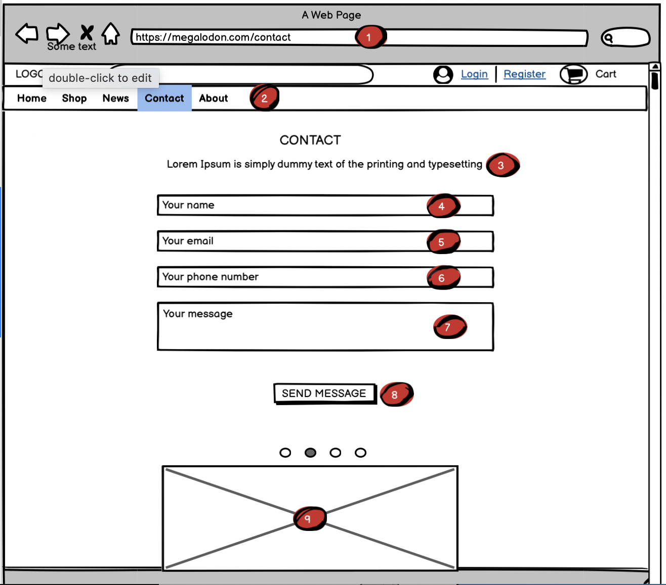
contact
DESCRIPTION (Contact)
1. Firstly, visit the link to the Homepage.
2.Click “Contact” to access this section page.
3. This may contains some details about our contents to section “Contact”
4,5,6,7. You’ll type your information and desire in here to contact us
8. Click this button to transport the above databases to us.
9. The information will shaded with your each mouse’s move.

Slide 41
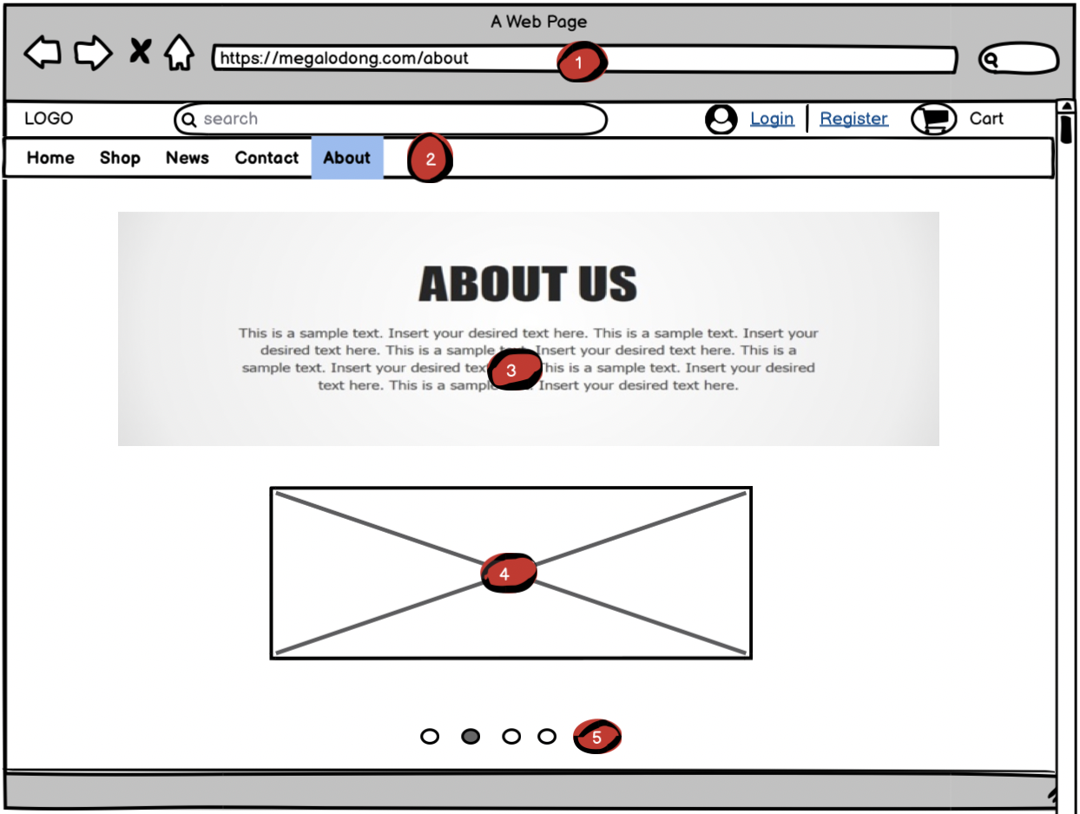
about
DESCRIPTION (About)
1. Firstly, visit the link to the Homepage.
2.Click “About” to access this section page.
3.The information will shaded with your each mouse’s move.
4. Same as step 3
5. If you want to see another section, move your mouse in here.

Slide 42
the end
thanks for watching

